Slide 1
Topic modeling of social entrepreneur: A work note
Cheng-Jun Wang
2013 Sep 4

Slide 2
Outline
Basic knowledge of TM
Procedures of TM
Results:
Part 1
Part 2

Slide 3
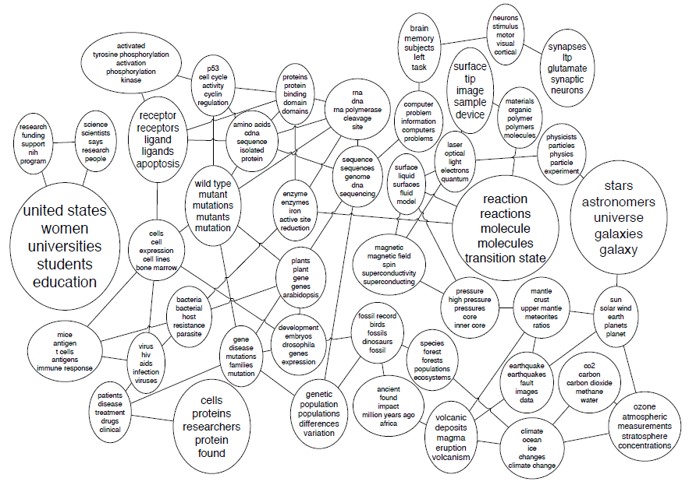
Background information
LDA vs. CTM
VEM vs. Gibbs sampling

Slide 4
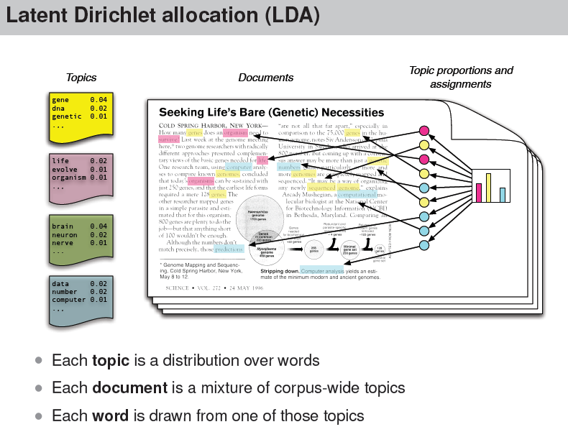

Slide 5
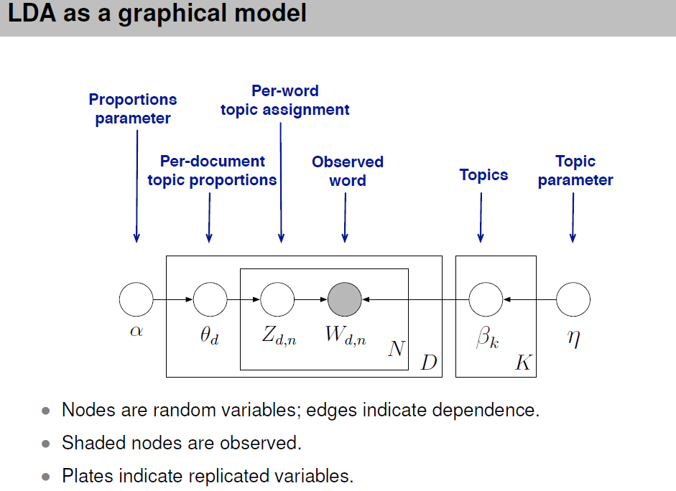

Slide 6
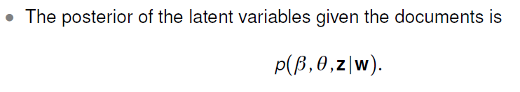
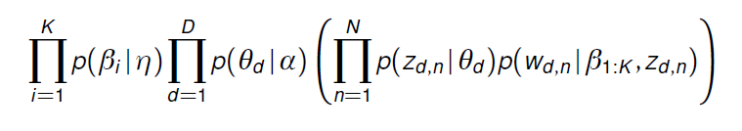
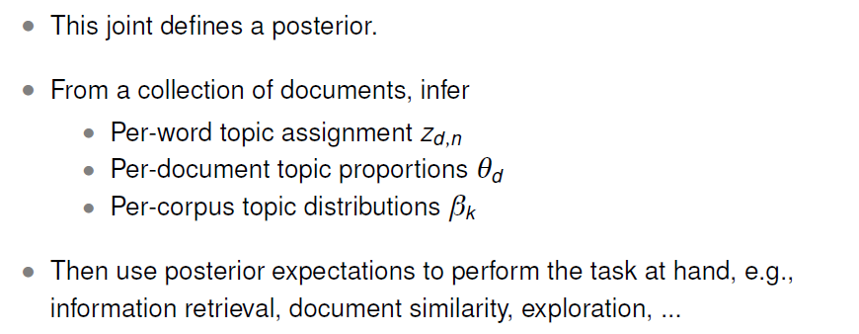

Slide 7
Step 1: Data pre-processing
dtm <- DocumentTermMatrix(corpus,
control = list(
stemming = TRUE,
stopwords = TRUE,
wordLengths=c(4, 15),
bounds = list(global = c(5,Inf)),
removeNumbers = TRUE,
removePunctuation = list(preserve_intra_word_dashes = FALSE),
encoding = "UTF-8"

Slide 8
Step 2: Identify the number of topics by calculating the perplexity
Using 10-fold cross-validation
Train topic models with 90% data, and test with the other 10% data
To model an unknown probability distribution p, based on a training sample that was drawn from p. Given a proposed probability model q, one may evaluate q by asking how well it predicts a separate test sample x₁, x₂, ..., x_{N} also drawn from p. The perplexity of the model q is defined as:

Slide 9
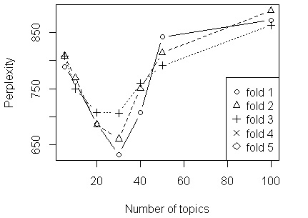
Better models q of the unknown distribution p will tend to assign higher probabilities q(x_{i}) to the test events. Thus, they have lower perplexity: they are less surprised by the test sample.

Slide 10
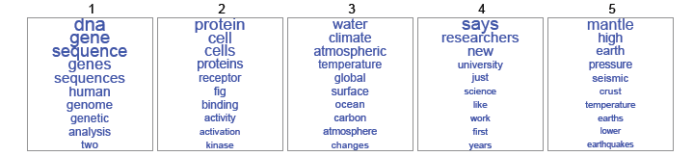
Step 3: Get the topic-term matrix and topic-document matrix
rs = posterior(jss_TM$CTM, dtm)
rs$topics # topics and documents
rs$terms # topic and terms

Slide 11

Part 1: schwab
The Schwab Foundation for Social Entrepreneurship provides unparalleled platforms at the regional and global level to highlight and advance leading models of sustainable social innovation.

Slide 12
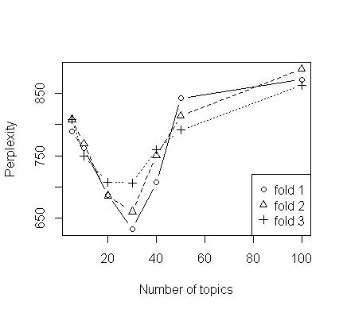
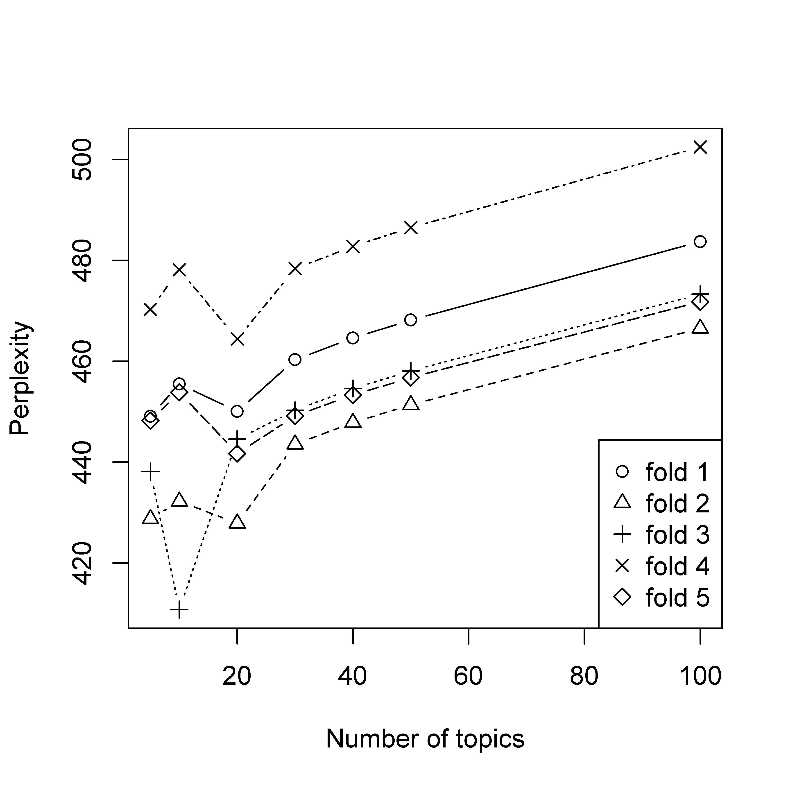
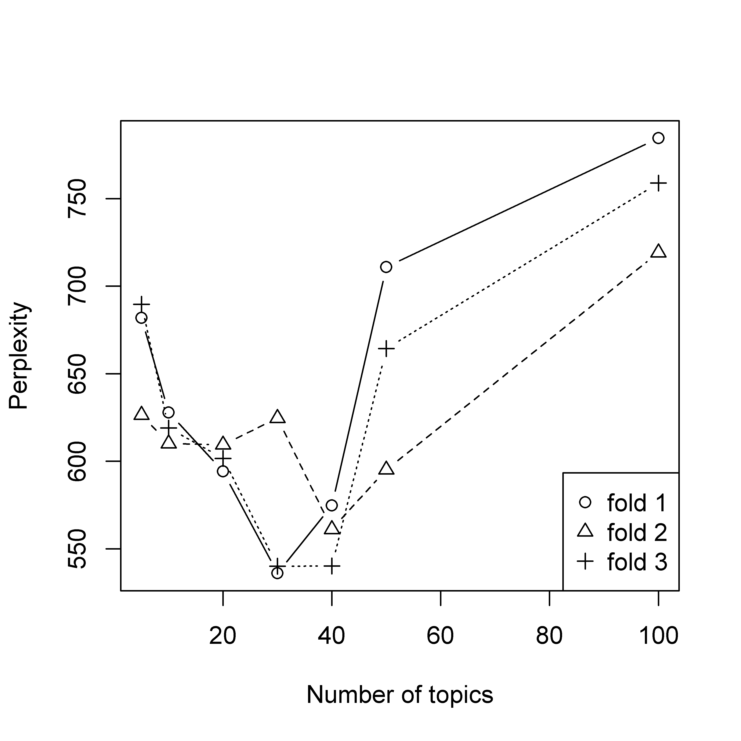
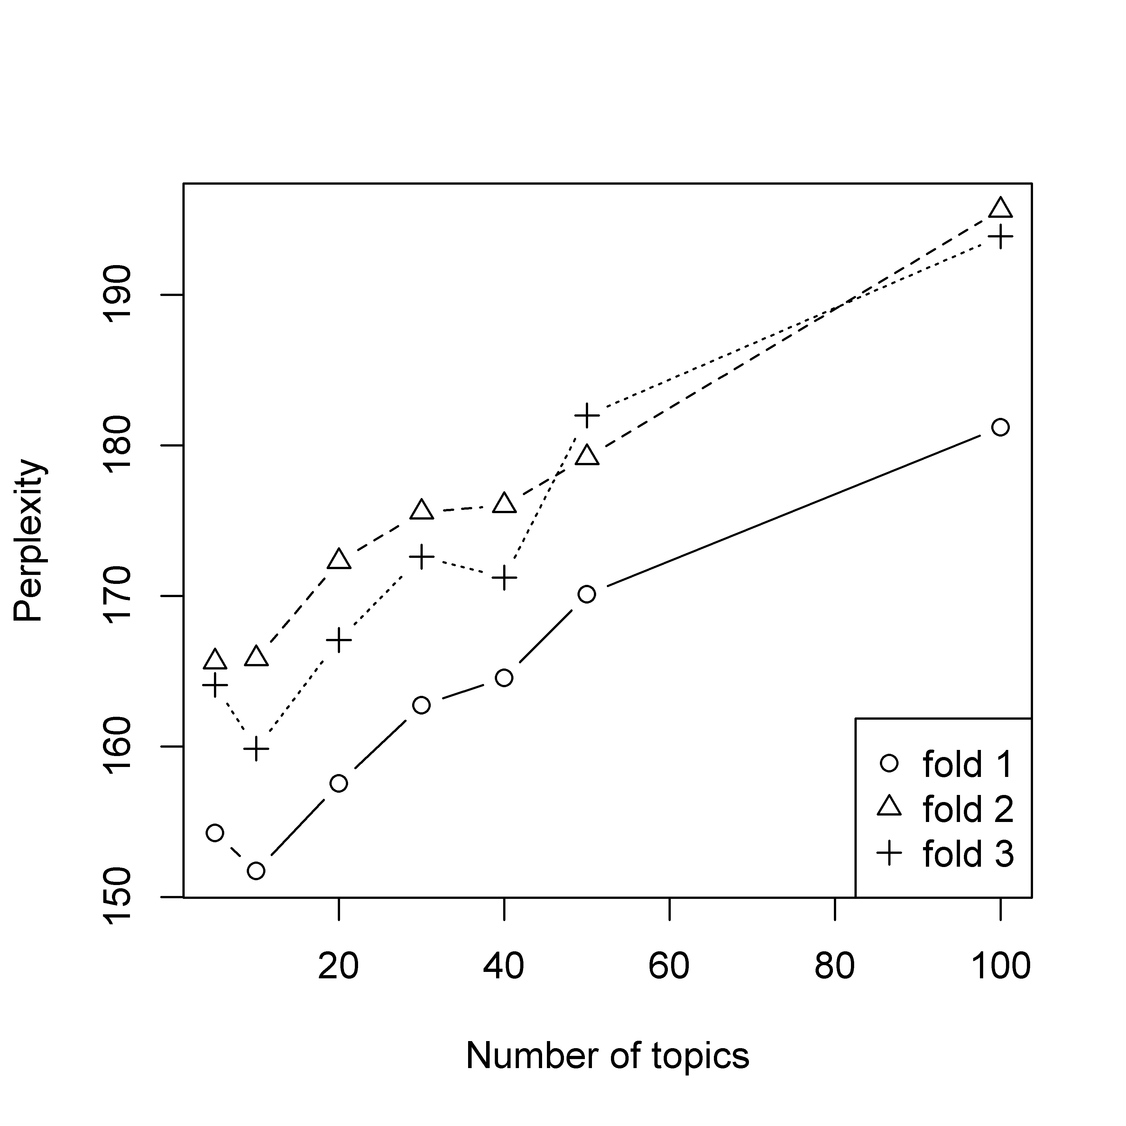
Background
Entrepreneur
Innovation
Short Introduction

Slide 13
Background
 | Topic 1 | Topic 2 | Topic 3 | Topic 4 | Topic 5 | Topic 6 | Topic 7 | Topic 8 | Topic 9 | Topic 10
1 | rural | educ | disabl | servic | educ | train | develop | health | school | peopl
2 | land | school | peopl | develop | student | construct | peopl | medic | children | vision
3 | women | youth | activ | rural | river | afford | children | servic | educ | million
4 | electr | student | servic | client | teacher | local | medic | patient | student | glass
5 | famili | teacher | social | farmer | learn | villag | activ | provid | youth | develop
 | Topic 11 | Topic 12 | Topic 13 | Topic 14 | Topic 15 | Topic 16 | Topic 17 | Topic 18 | Topic 19 | Topic 20
1 | poor | water | peopl | servic | provid | vehicl | sustain | work | work | entrepreneur
2 | communiti | villag | disabl | worker | develop | bank | resourc | employ | artisan | econom
3 | rural | children | access | social | communiti | world | work | product | mother | world
4 | activ | provid | children | bank | million | organ | bioregion | social | famili | countri
5 | servic | famili | book | migrant | activ | manag | live | peopl | hiv | rural
 | Topic 21 | Topic 22 | Topic 23 | Topic 24 | Topic 25 | Topic 26 | Topic 27 | Topic 28 | Topic 29 | Topic 30
1 | product | hous | wast | communiti | women | social | communiti | sustain | develop | area
2 | rural | poor | develop | health | use | famili | local | develop | innov | social
3 | entrepreneur | live | activ | mani | equip | help | citi | organ | new | peopl
4 | communiti | slum | organ | activ | activ | communiti | urban | activ | product | live
5 | need | communiti | recycl | live | communiti | creat | develop | food | communiti | program

Slide 14
Entrepreneur
 | Topic 1 | Topic 2 | Topic 3 | Topic 4 | Topic 5 | Topic 6 | Topic 7 | Topic 8 | Topic 9 | Topic 10
1 | socil | yer | socil | tht | awrd | develop | work | awrd | socil | work
2 | work | indigen | awrd | develop | socil | work | tht | socil | compni | jne
3 | develop | togeth | work | educt | univers | project | yer | work | tht | mngement
4 | progrmm | cquir | univers | work | work | school | found | peopl | yer | fellow
5 | yer | first | develop | yer | communiti | yer | slum | citi | orgnizt | world
6 | busi | socil | right | socil | degre | technolog | sinc | tht | provid | public
7 | orgnizt | mni | foundtion | busi | ateneo | experi | interntionl | develop | build | posit
8 | entrepreneur | right | found | children | mnil | environmentl | orgnizt | educt | serv | young
9 | estblish | club | sekem | peopl | yer | engin | first | help | develop | busi
10 | entrepreneurship | friend | recogn | school | institut | receiv | need | disbl | work | studi
 | Topic 11 | Topic 12 | Topic 13 | Topic 14 | Topic 15 | Topic 16 | Topic 17 | Topic 18 | Topic 19 | Topic 20
1 | develop | busi | work | socil | school | sustinbl | tht | tht | univers | innovt
2 | tht | univers | nigeri | ledership | develop | develop | awrd | univers | awrd | tech
3 | mngement | develop | socil | peopl | educt | work | world | work | servic | communiti
4 | awrd | indi | awrd | serv | work | univers | fellow | develop | serv | univers
5 | indi | time | interntionl | work | univers | compni | helth | women | receiv | ceo
6 | helth | socil | lso | globl | socil | one | interntionl | educt | tht | work
7 | found | tht | specil | busi | fellow | new | univers | peopl | lern | amer
8 | public | world | energi | sector | entrepreneurship | led | globl | degre | school | cofound
9 | univers | engin | telpk | vision | first | oliveir | econom | afric | yer | provid
10 | bngldesh | peopl | disbl | south | busi | nercessin | work | unit | microfinnc | wht

Slide 15
Innovation
 | Topic 1 | Topic 2 | Topic 3 | Topic 4 | Topic 5 | Topic 6 | Topic 7 | Topic 8 | Topic 9 | Topic 10
1 | develop | villag | busi | disabl | busi | artisan | develop | electr | sustain | wast
2 | social | rural | pizzo | peopl | unit | work | servic | develop | project | collect
3 | children | construct | regionalwert | employ | rat | artist | busi | famili | communiti | recycl
4 | creat | product | region | provid | programm | one | also | communiti | carbon | compani
5 | servic | train | pay | aid | cooper | addit | group | system | compani | manag
 | Topic 11 | Topic 12 | Topic 13 | Topic 14 | Topic 15 | Topic 16 | Topic 17 | Topic 18 | Topic 19 | Topic 20
1 | educ | ytf | organ | peopl | women | communiti | innov | farmer | children | world
2 | school | work | compani | work | includ | centr | health | support | communiti | toilet
3 | develop | children | peopl | provid | social | local | mobil | communiti | project | sanit
4 | student | academi | volunt | communiti | product | cooper | new | train | urban | global
5 | land | communiti | product | employ | train | develop | open | local | busi | comic
 | Topic 21 | Topic 22 | Topic 23 | Topic 24 | Topic 25 | Topic 26 | Topic 27 | Topic 28 | Topic 29 | Topic 30
1 | servic | program | care | health | servic | health | bank | social | communiti | youth
2 | peopl | dot | provid | peopl | provid | commcar | provid | develop | product | peopl
3 | young | local | eye | develop | loan | chw | servic | communiti | rural | offer
4 | emerg | network | patient | bicycl | migrant | communiti | client | organ | hapinoy | market
5 | provid | train | servic | healthcar | develop | improv | poor | manag | villag | environment
 | Topic 31 | Topic 32 | Topic 33 | Topic 34 | Topic 35 | Topic 36 | Topic 37 | Topic 38 | Topic 39 | Topic 40
1 | light | communiti | sustain | efe | educ | social | conserv | busi | health | social
2 | solar | farmer | develop | educ | school | busi | environment | social | servic | develop
3 | energi | econom | sekem | market | student | develop | ipe | manag | communiti | peopl
4 | member | develop | project | peopl | teacher | communiti | lifeg | train | provid | provid
5 | servic | organ | organ | chang | train | organ | sustain | communiti | work | communiti

Slide 16
Short Introduction
 | Topic 1 | Topic 2 | Topic 3 | Topic 4 | Topic 5
1 | social | develop | econom | poor | sustain
2 | compani | social | organ | help | world
3 | develop | support | educ | develop | busi
4 | product | sustain | communiti | urban | live
5 | farm | work | opportun | women | provid
6 | peopl | educ | lowincom | promot | benefit
7 | communiti | improv | develop | cultur | product
8 | valu | help | social | work | condit
9 | farmer | individu | nation | new | million
10 | organ | econom | improv | rural | practic
 | Topic 6 | Topic 7 | Topic 8 | Topic 9 | Topic 10
1 | water | rural | health | provid | technolog
2 | solar | villag | servic | servic | peopl
3 | energi | servic | qualiti | train | promot
4 | innov | provid | provid | job | develop
5 | world | communiti | access | youth | use
6 | area | afford | medic | busi | educ
7 | develop | sustain | care | creat | programm
8 | technolog | train | work | societi | improv
9 | system | work | improv | programm | young
10 | empow | develop | children | opportun | social

Slide 17

Part 2: ASHoKA
Ashoka is the largest network of social entrepreneurs worldwide, with nearly 3,000 Ashoka Fellows in 70 countries putting their system changing ideas into practice on a global scale.

Slide 18
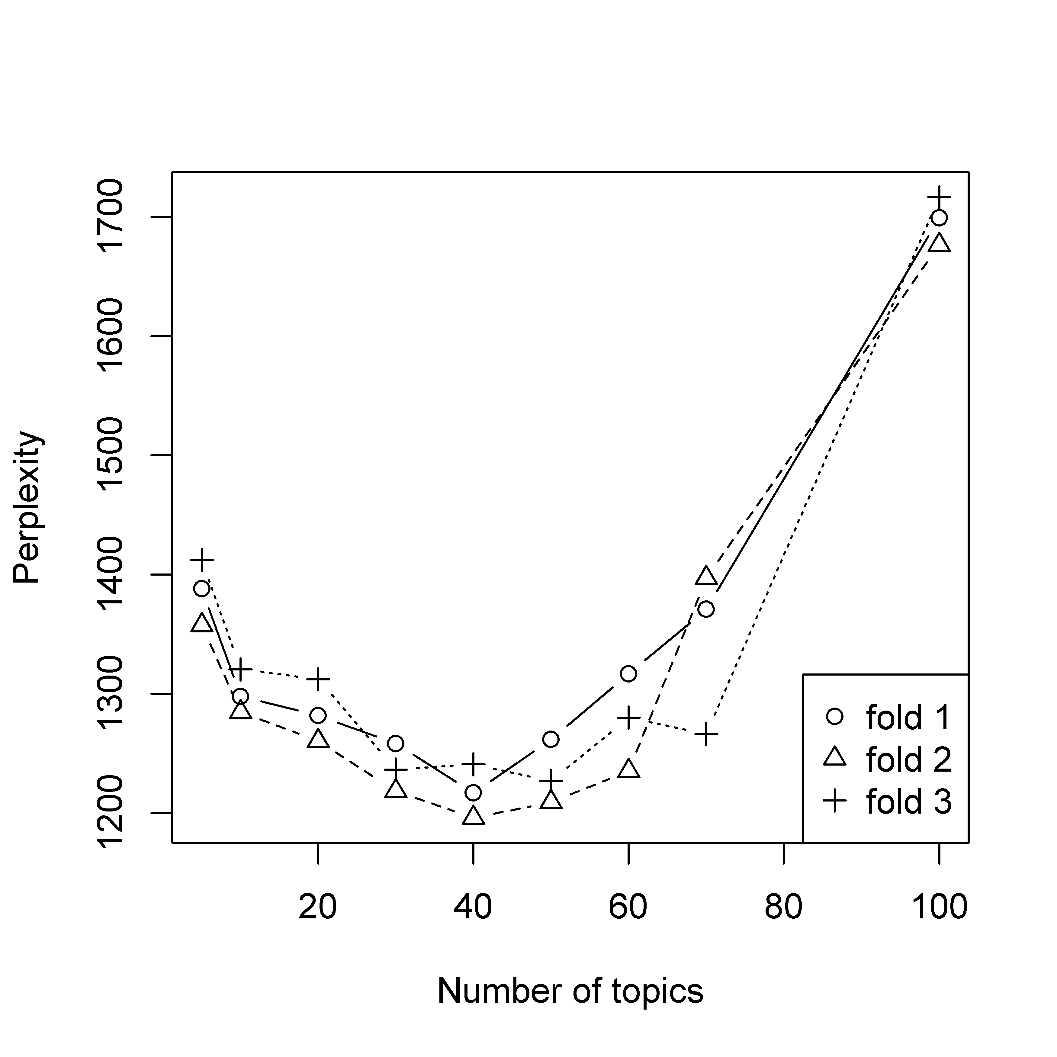
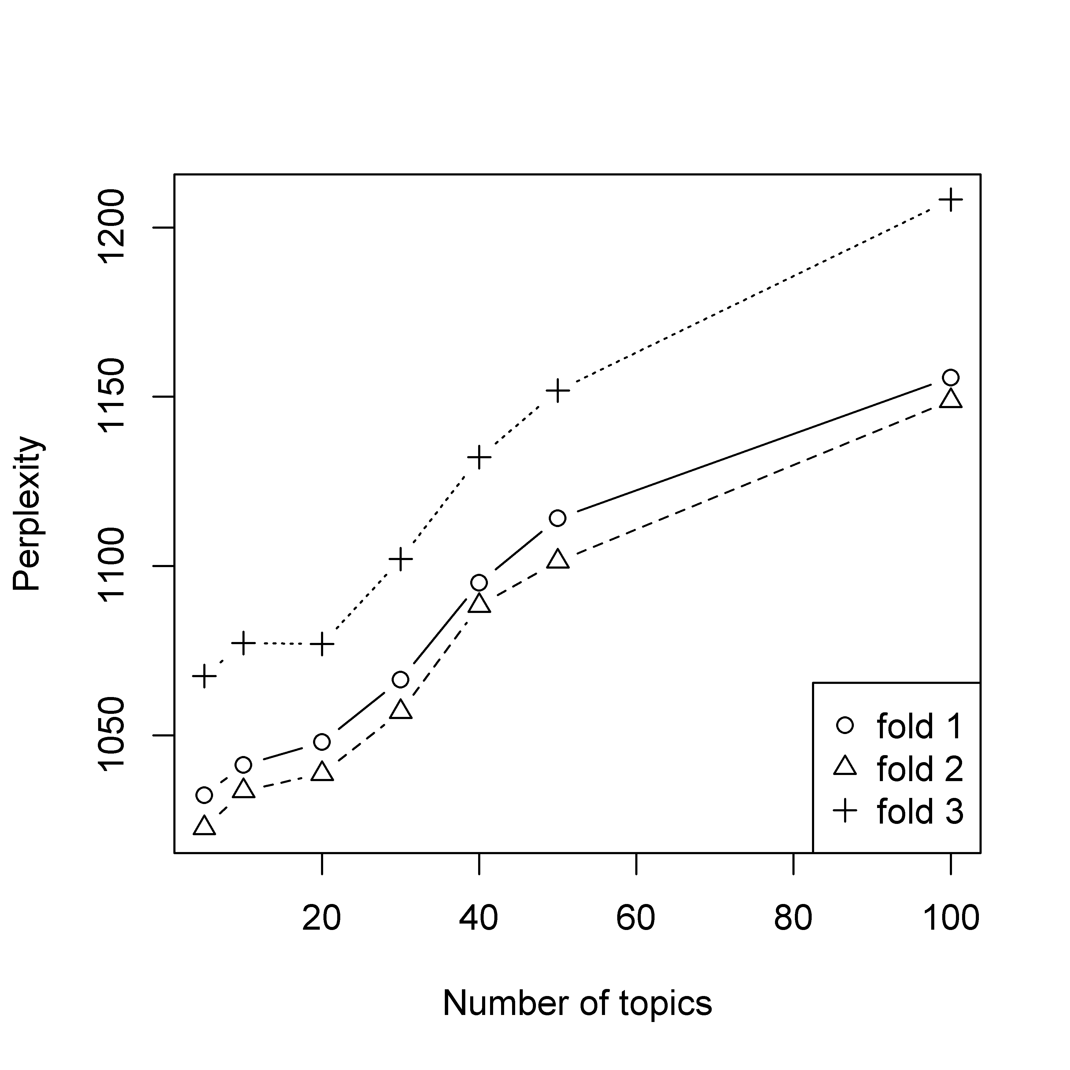
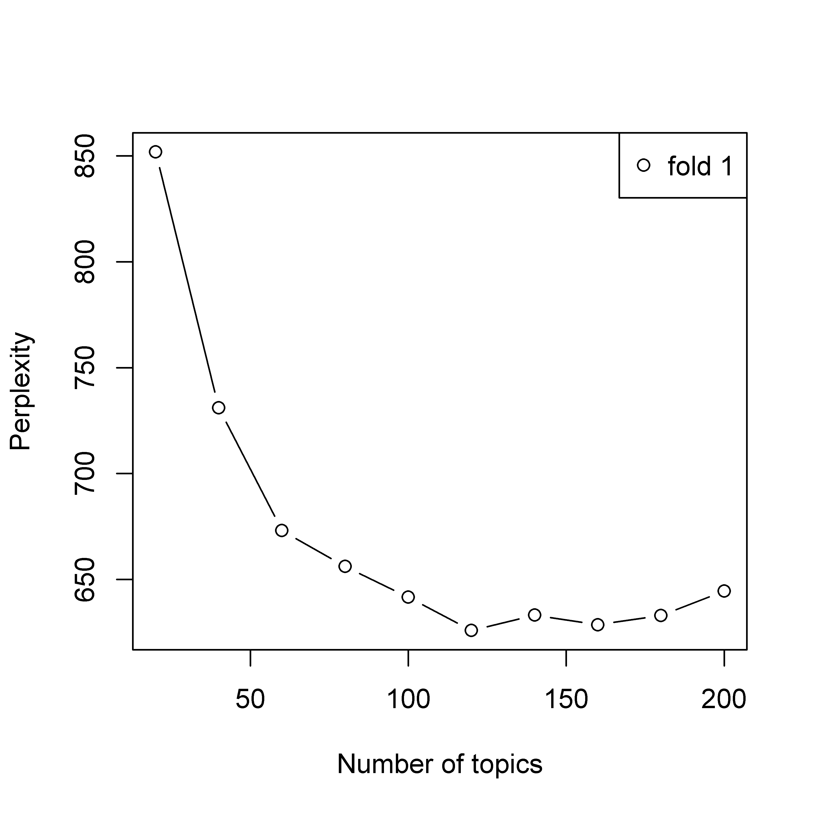
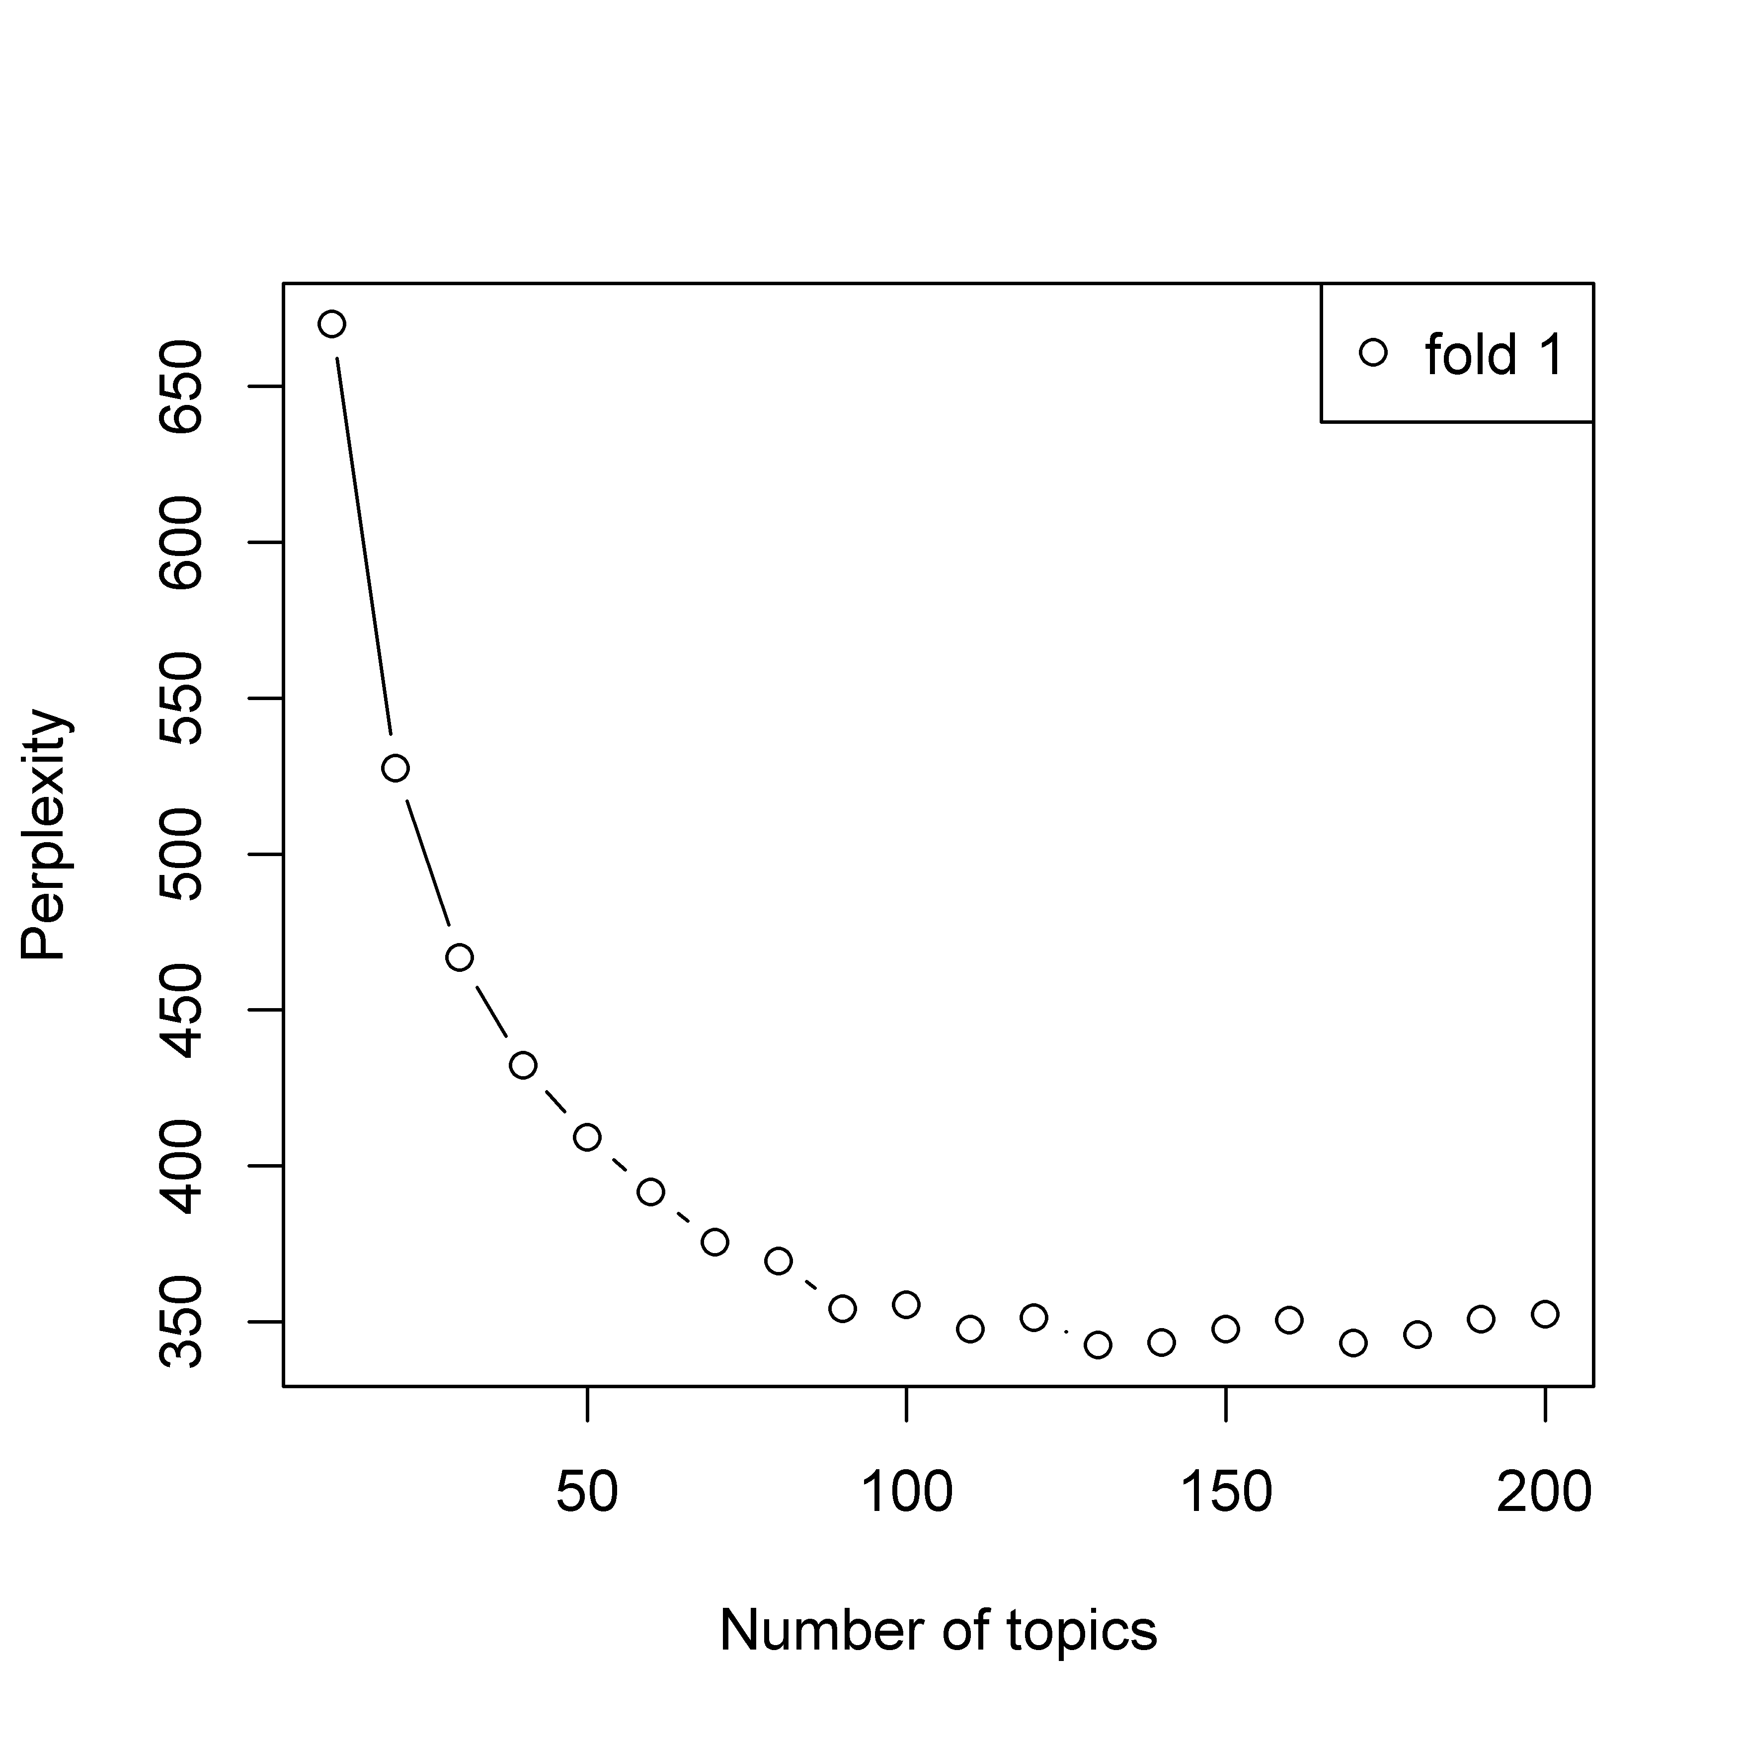
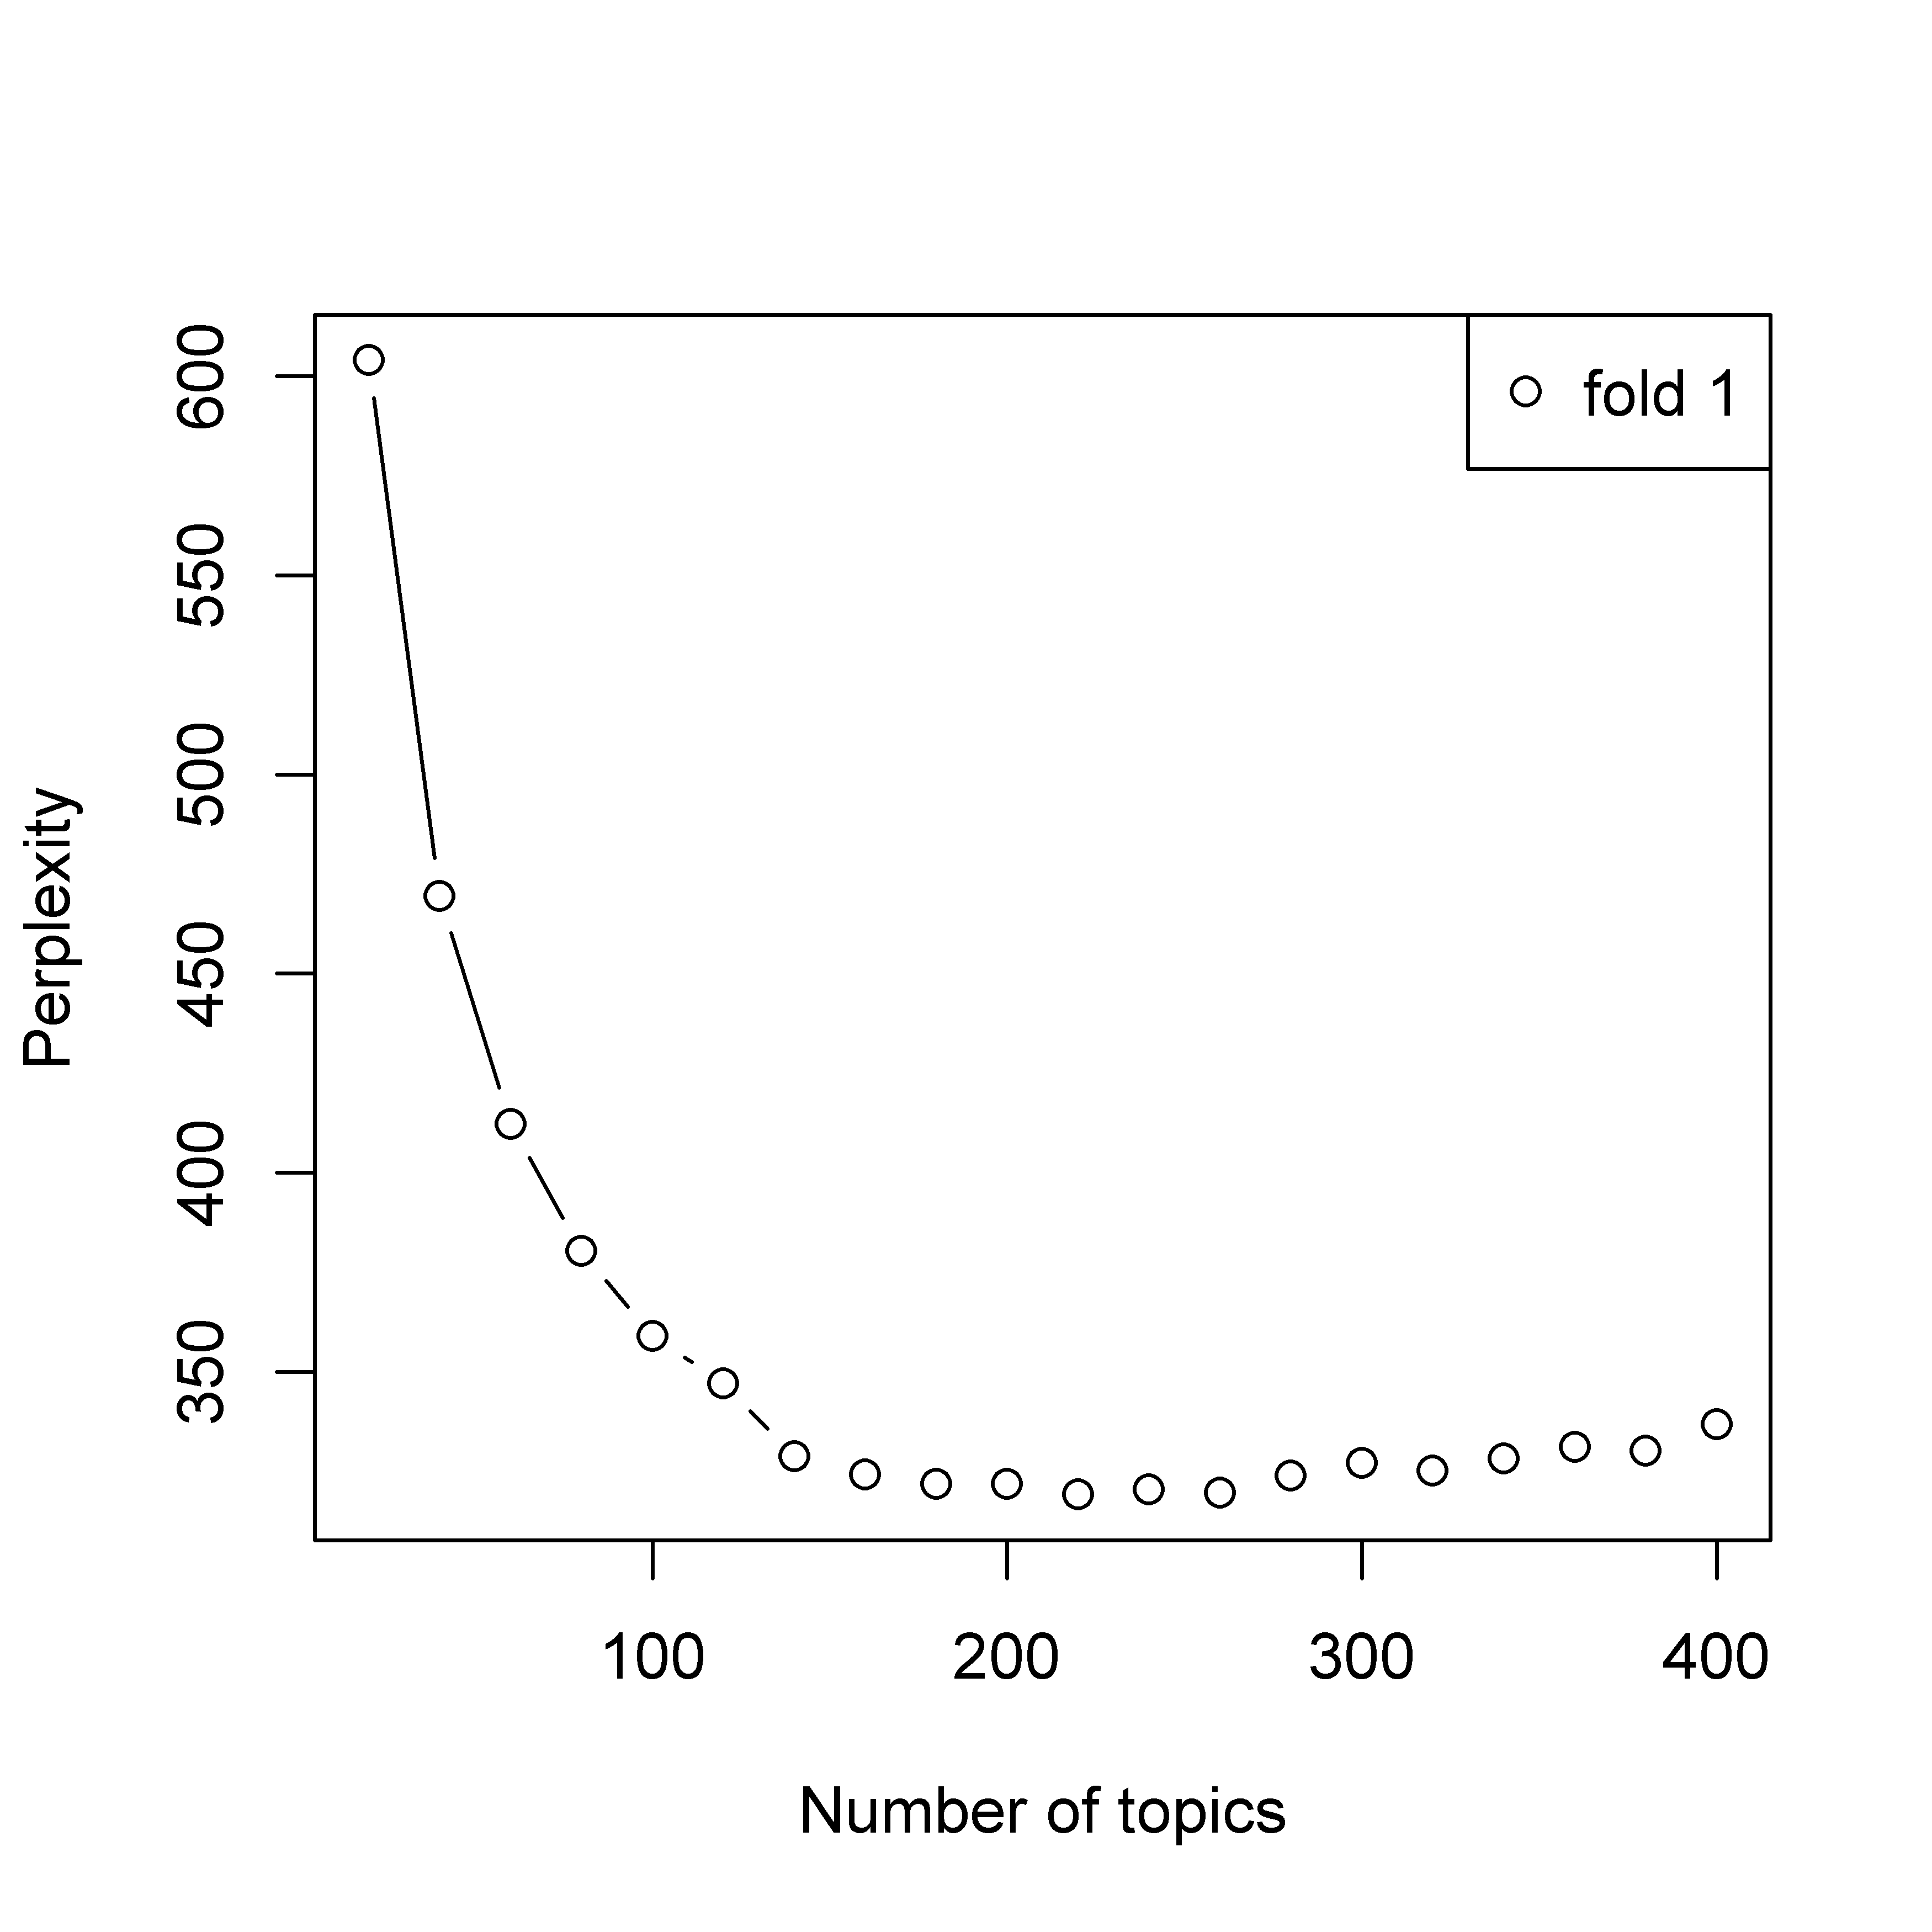
idea
Intro
Person
Problem
Strategy

Slide 19
Intro
 | Topic 1 | Topic 2 | Topic 3 | Topic 4 | Topic 5
1 | women | women | environment | busi | women
2 | environment | center | disabl | communic | protect
3 | human | conserv | women | produc | student
4 | farmer | violenc | busi | learn | legal
5 | worker | farmer | field | hous | land
6 | foster | legal | prevent | univers | citi
7 | mental | villag | livelihood | valu | environment
8 | student | human | strategi | polit | center
9 | industri | food | offer | teach | campaign
10 | disabl | forest | technolog | technolog | altern

Slide 20
Strategy
Number of topics for Strategy = 180
Topic 1 | women | michal | sport | girl | highway | sister | athlet | fenc | ambul | villag
Topic 2 | forest | javier | campus | energi | amazon | clinic | wood | wildlif | speci | bandung
Topic 3 | mike | mexican | user | emiss | carbon | mexico | bioga | fertil | nepal | csos
Topic 4 | export | consum | mexico | coffe | union | bird | investor | breed | mari | grower
Topic 5 | station | broadcast | veteran | victoria | afterschool | ciudadano | news | journalist | teen | weaver
Topic 6 | medicin | mexico | camp | mauricio | sibl | clinic | treatment | healer | indigen | bengal
Topic 7 | farmer | crop | farm | villag | plant | water | tree | seed | speci | irrig
Topic 8 | dream | farm | villag | farmer | anim | rabbit | livestock | breed | clinic | agribusi
Topic 9 | hospit | plant | medicin | tortur | soul | township | conserv | cell | amazon | anemia
Topic 10 | migrant | burmes | thai | william | thailand | francisco | paul | journalist | solar | daniel

Slide 21
To do list

